Slide 1
Geochemistry of Igneous Processes
Introduction
Igneous rocks are often termed primary rocks
Derived from processes including melting of rocks beneath the surface of the earth, magma accent, emplacement, differentiation and crystallization
Different types of rocks result from magmatic processes
The difference in rocks is principally a function of chemical composition, along of course, with the environment of emplacement (operative physical conditions)
Major elements (e.g. Mg, Ca, K, Na, Al & Si) in the magma form silicate phases of their own; minor (e.g. P, Mn, Ti) and trace (e.g. Cr, Ni, Zn, Pb) elements usually substitute for the major elements in minerals

Slide 2
Magma Differentiation & Element Distribution
Major Elements
During magma crystallization, elements distribute themselves & separate out according to fairly uniform patterns
Among the major elements, Mg & Ca leave the melt early and at high temperature to form the ultramafic/mafic minerals e.g. olivine, pyroxene & the calc-plagioclases
Most of the alkali metals (Na, K) separate out at the latter stages, explaining their abundance in felsic phases e.g. alkali feldspar and mica (e.g. muscovite)
Aluminium goes into the feldspar at all stages and in micas in the late stage processes
The case of Fe is an interesting one, for it may appear at any stage of the process. Fe is found in some olivine (fayalite) and also in mica during the latter stages of magma differentiation

Slide 3
Behaviour of Trace Elements in Magma
Trace elements do not form rock forming silicates of their own, they substitute for relevant major ones in their phases
This often follows simple or uniform rates of substitution, based on ionic charge & radius and the general behaviour of the element concerned
Goldschmidt formulated the following rules to guide substitution:
two ions of same radius and charge will enter a crystal lattice with equal ease;
if two ions have similar radii and the same charge, the smaller will preferentially enter a growing crystal; and
where two ions have similar radii but differ in charge, that with the higher charge will enter a crystal more readily.

Slide 4
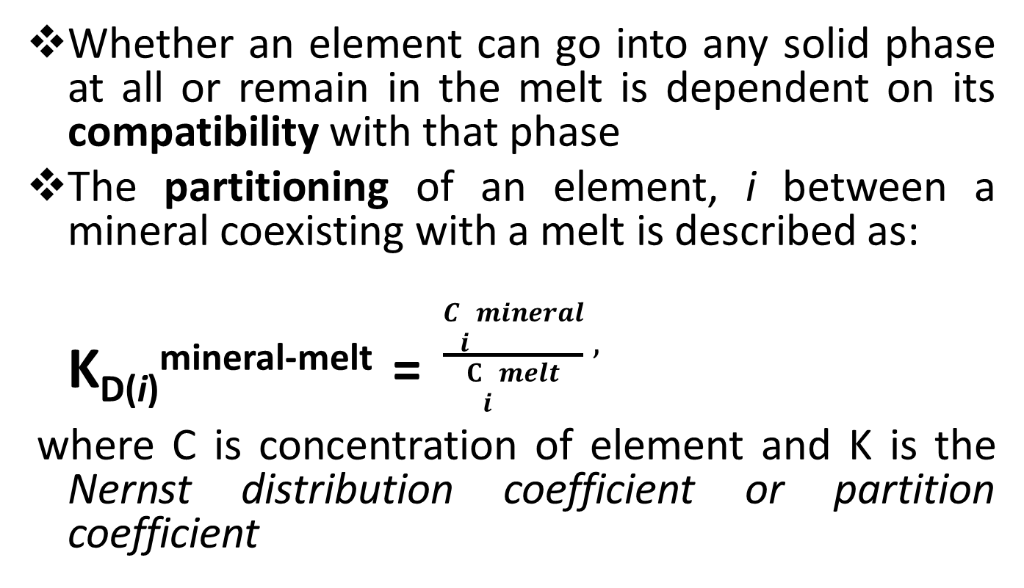
Trace Elements Cont’d
Whether an element can go into any solid phase at all or remain in the melt is dependent on its compatibility with that phase
The partitioning of an element, i between a mineral coexisting with a melt is described as:
K_{D(i)}^{mineral-melt} = $\frac{Ci mineral}{Ci melt},$
where C is concentration of element and K is the Nernst distribution coefficient or partition coefficient

Slide 5
Trace elements cont’d
Mineral-melt partition coefficients can be determined from analysis of minerals and their glassy matrix in rapidly cooled lava (glass matrix is thought to represent the melt)
This can also be achieved from experiments, if the right conditions are attained in the laboratory, by doping natural or synthetic working materials with elements of interest
The value of the partition coefficient is affected by composition of the melt, temperature, oxygen fugacity and crystal chemistry of the minerals
Trace elements with K_{D(i)}^{mineral-melt} greater than 1 are preferentially concentrated in the solid phases i.e. mineral crystals and are therefore called compatible elements
Those with values < 1 are incompatible elements and remain within the melt phase

Slide 6
Trace elements cont’d
Some elements(e.g. P) exhibit variable behaviour depending on whether the melting involves mantle or continental granitic rocks
Incompatible elements are divided into high field strength (HFS, ionic potential > 2) and low field strength (LFS, ionic potential < 2 ) elements
The HFS elements ( e.g. U, Zr, Hf, Nb, Ta, Ti) do not normally substitute for major elements
The LFS elements ( e.g. Cs, Rb, Ba, Sr) along with REEs La & Ce are also referred to as large ion lithophiles (LIL) and are often concentrated in the late stage products of magmatic crystallization
Elements such as Ni, Cr, Cu, W, Os, Ir, Pt & Au with small ionic radii and relatively low charges tend to go into (are compatible with) early formed phases
Concentration of compatible elements decreases while that of incompatible elements generally increases with increased magma differentiation ( as indexed by increasing SiO₂ content)

Slide 7
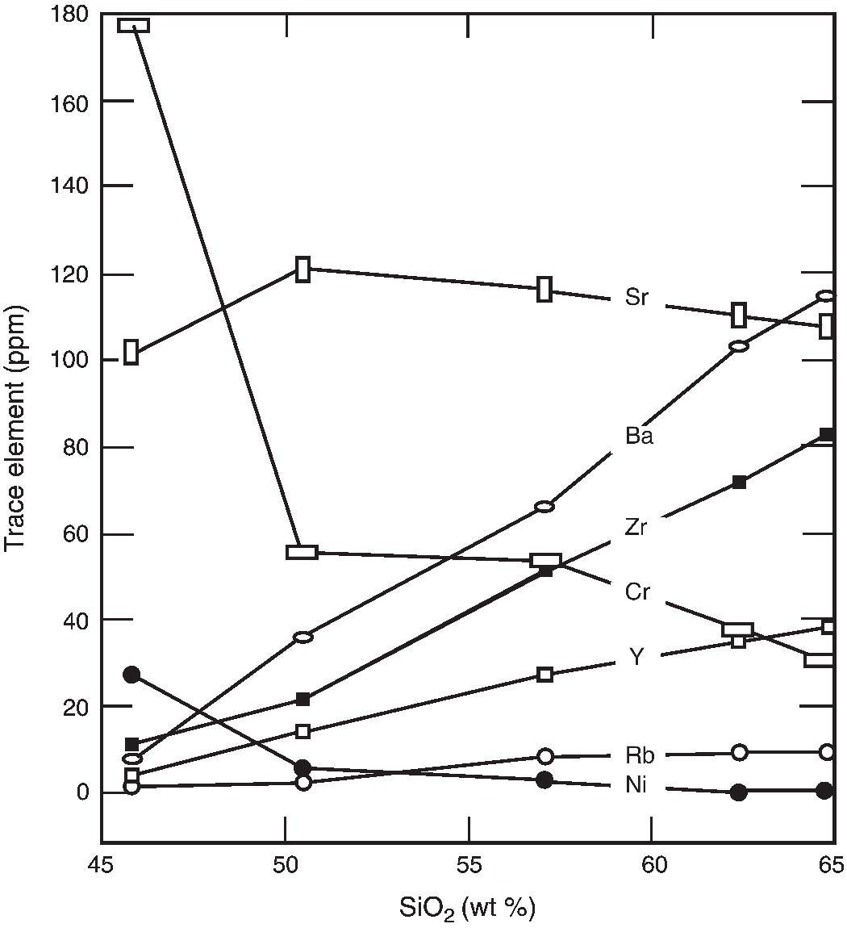
Fig.1: Distribution Trends of some trace elements in a mafic-to-felsic differentiated suite of volcanic rocks (Misra, 2012)

Slide 8
Trace elements cont’d
Chalcophile elements commonly occur in igneous rocks as tiny sulfide grains, rather than as substitutes for major ions (with few exceptions, e.g. Zn for Mg & Fe, Bi for Ca).
They accumulate mostly in the late stage residual solutions injected into openings in felsic rocks
Some volatile metals or metalloids (e.g. Hg, As) go into the gaseous phases of magma; often lost to the atmosphere or trapped in fluid inclusions within the solidifying rocks

